Slide 1

Invasive Plants, Biodiversity and
Regional Planning
Doug Johnson, Executive Director
California Invasive Plant Council
www.cal-ipc.org

Slide 2
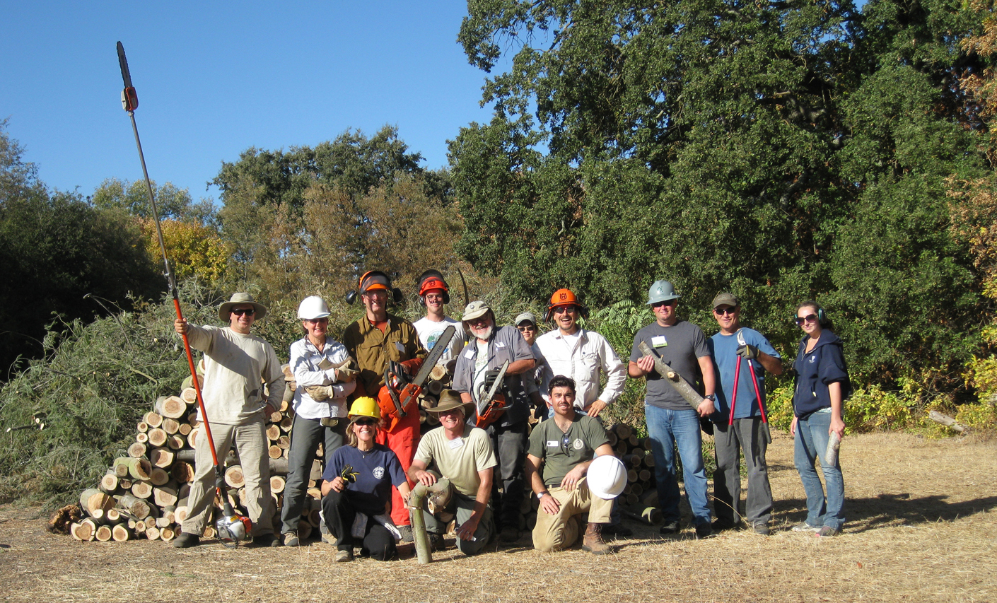
Who is Cal-IPC?

Slide 3
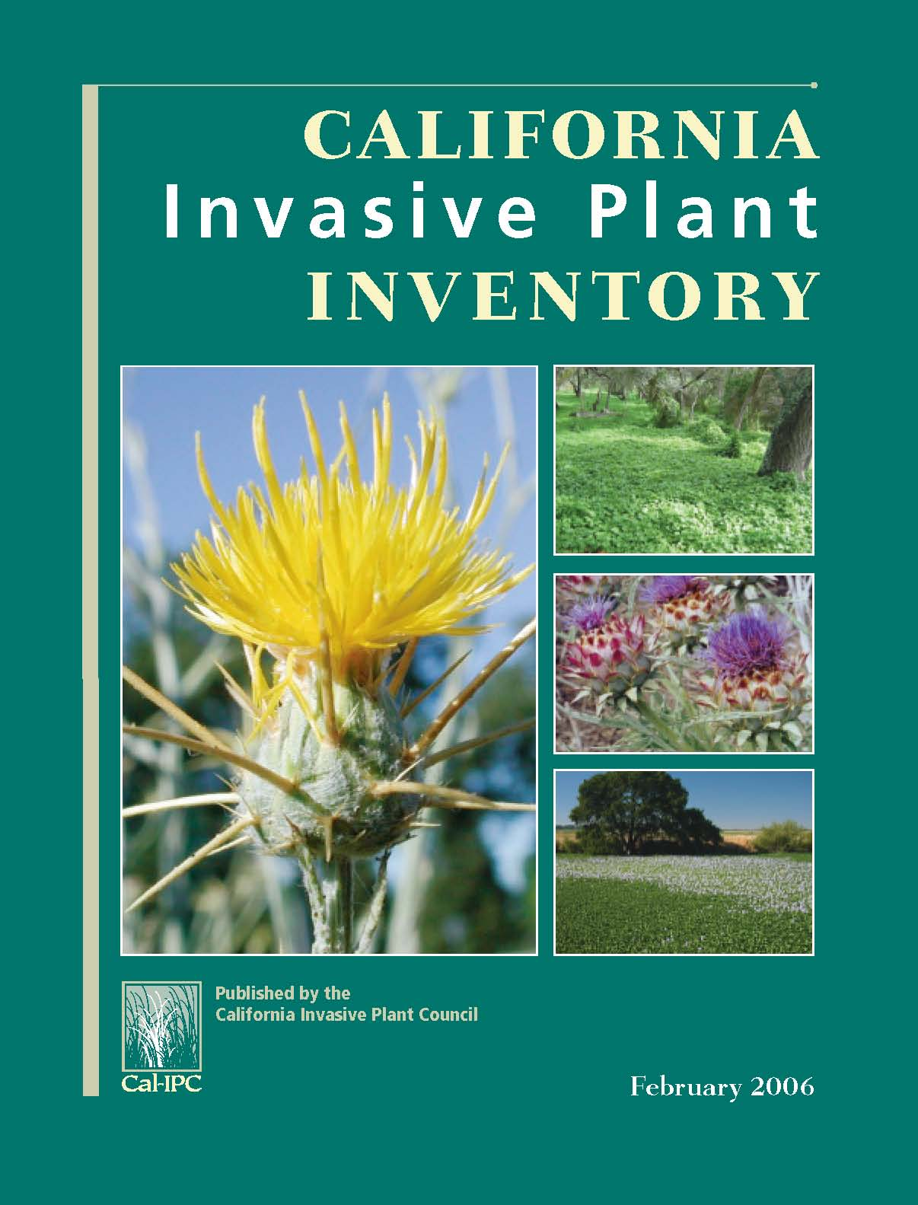
Cal-IPC Inventory
~200 species listed
…plus “watch list”
…all online in searchable dbase

Slide 4
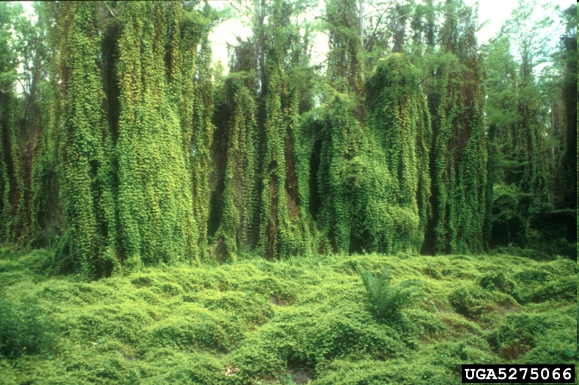
Invasive plants
100s of species nationwide
$30+ billion annual impact
1,000s of organizations
Tops in adaptation plans
Old world climbing fern (Lygodium microphyllum)

Slide 5
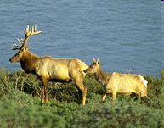
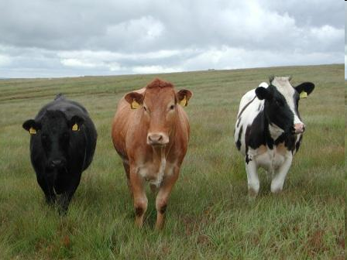
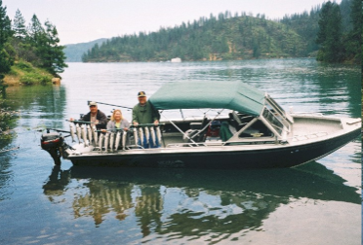
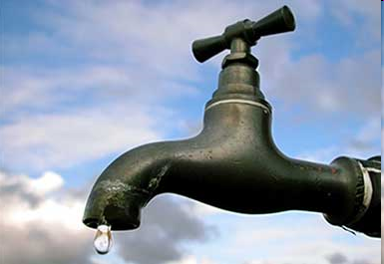
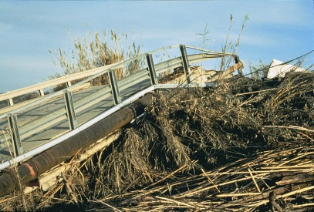
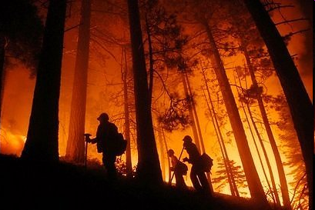
Impacts
Wildlife
Recreation
Infrastructure
Agriculture
Water
Fire

Slide 6
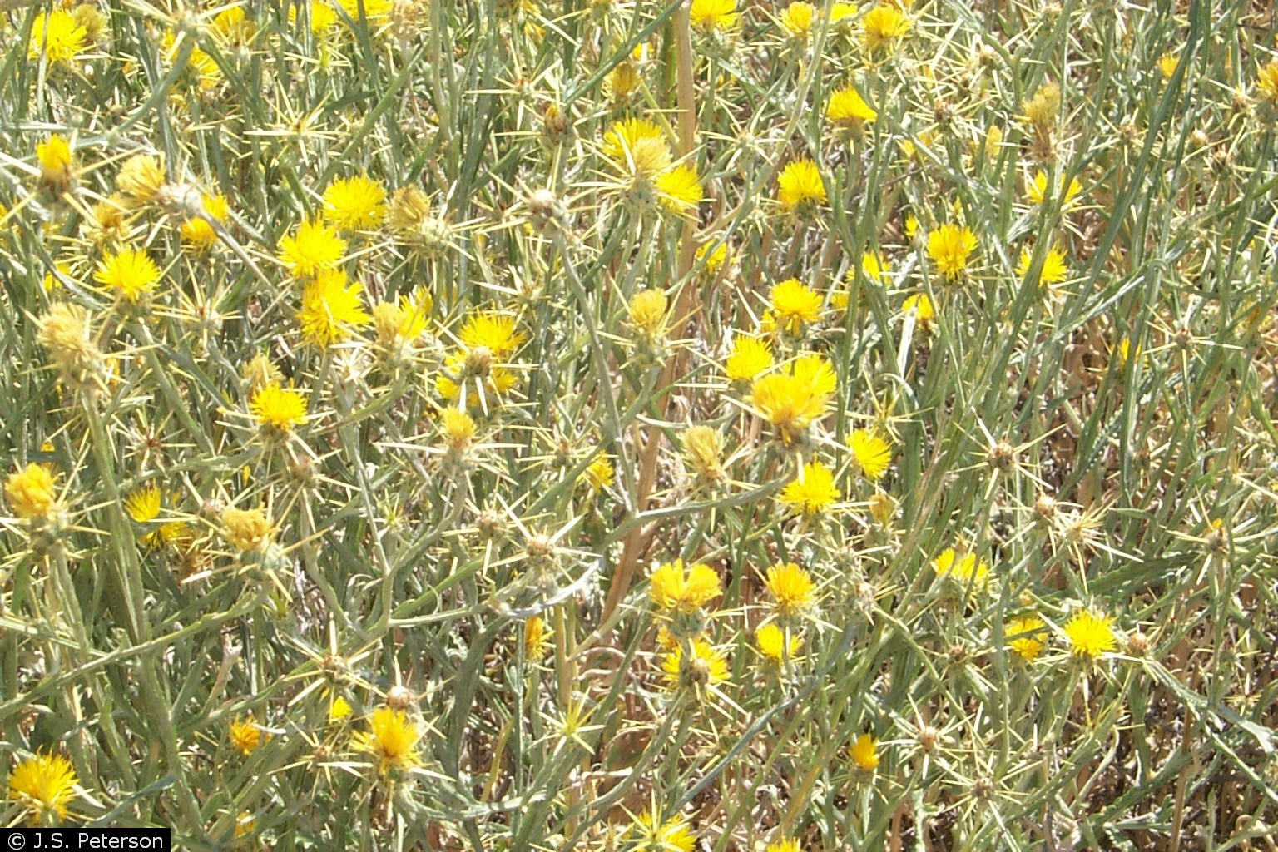
Yellow starthistle

Slide 7
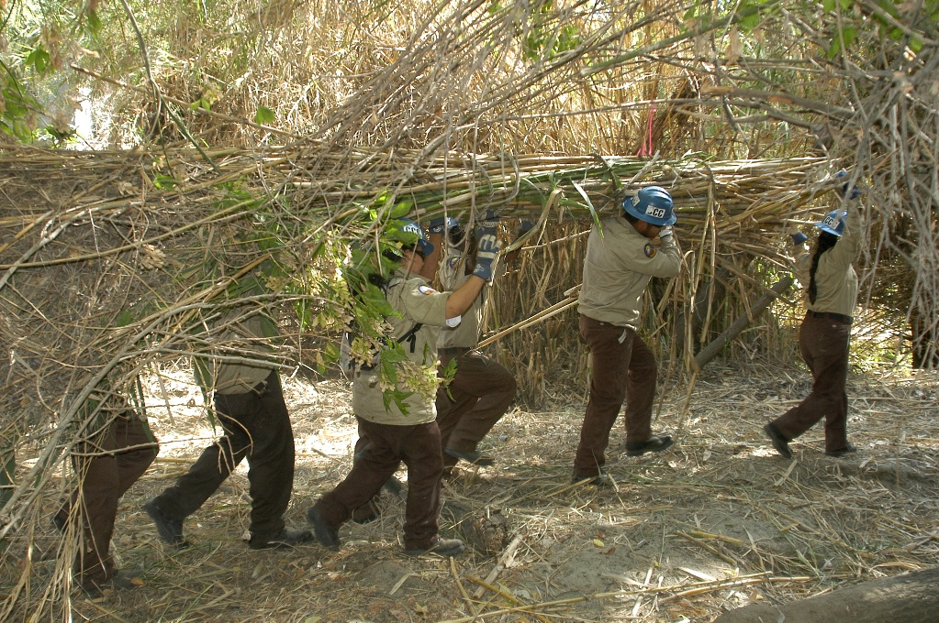
Arundo donax (giant reed)

Slide 8
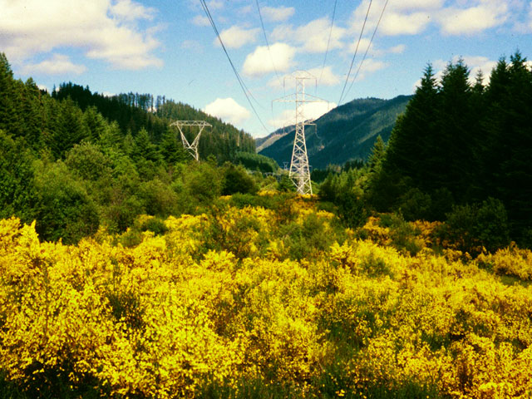
Scotch broom

Slide 9
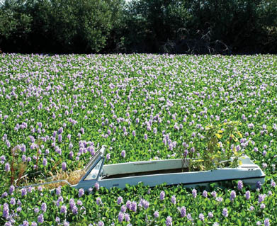
Water hyacinth

Slide 10
“Habitat loss is the single greatest threat to biodiversity, followed by the spread of alien species.”
Wilcove et al. in Bioscience 1998

Slide 11
“About 42% of the species on the Threatened or Endangered species lists are at risk primarily because of alien-invasive species.”
Pimentel et al. in Ecological Economics 2005

Slide 12
In California, 415 special status species are threatened by invasive plants.
California Natural Diversity Database

Slide 13
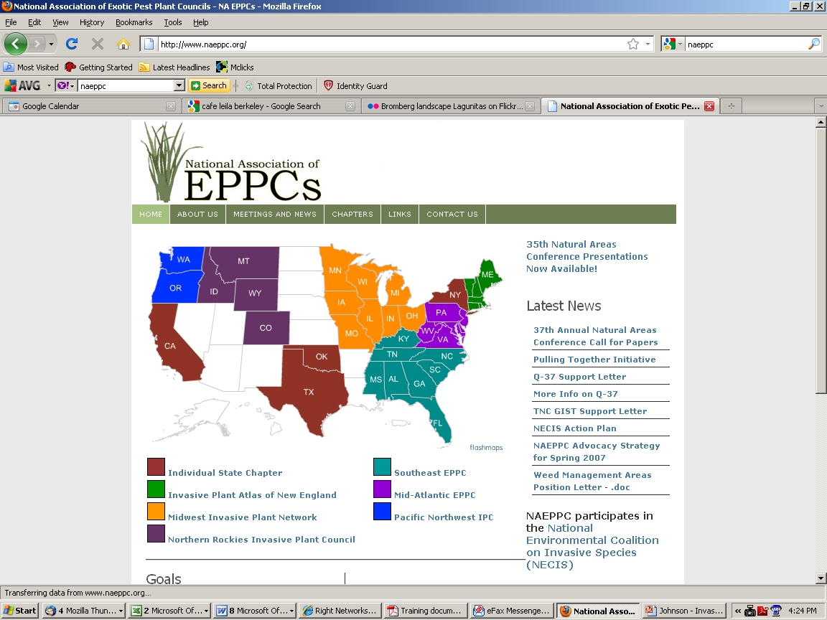
National effort

Slide 14
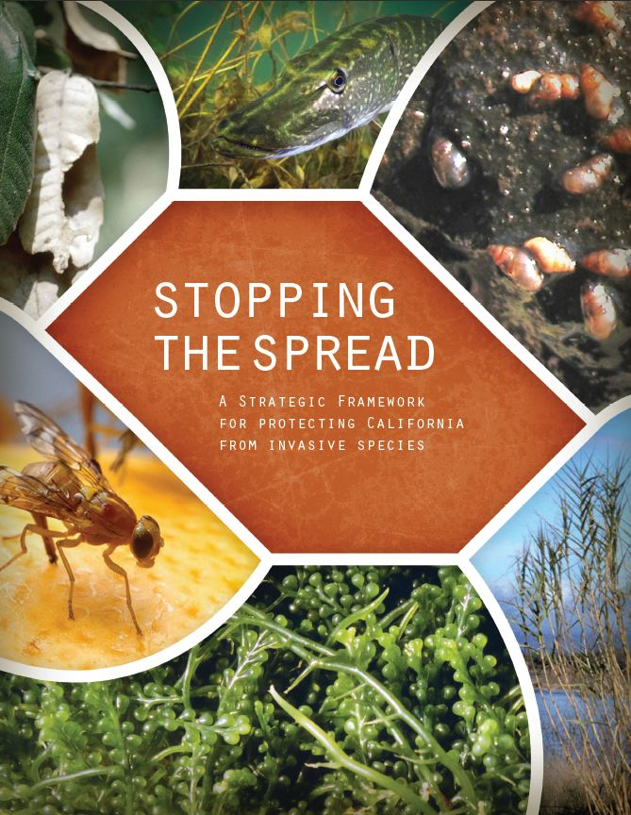
Interagency effort
CINIPC Strategic Blueprint on Landscape-Level Strategies for Invasive Plant Management (2013)
Advisory Committee’s Strategic Framework on Invasive Species (2012)

Slide 15

International crisis
UN Convention on Biological Diversity:
Article 8(h) states that “Each contracting Party shall, as far as possible and as appropriate, prevent the introduction of, control or eradicate those alien species which threaten ecosystems, habitats or species

Slide 16
Wildlife planning
State Wildlife Action Plan
…invasive species listed as major stressor in all regions

Slide 17
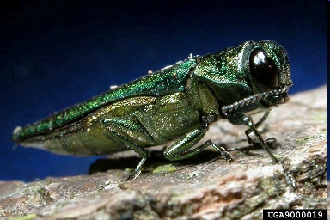
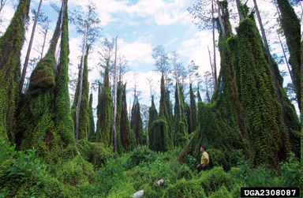
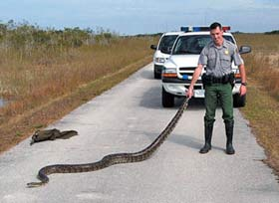
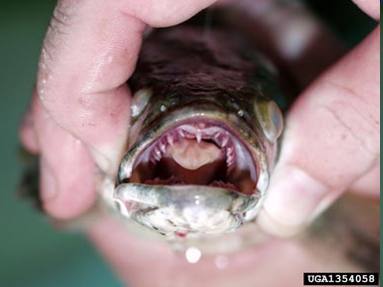
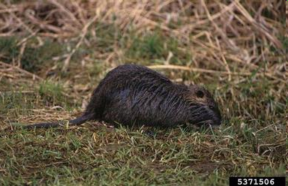
Plenty not here yet…

Slide 18

Climate change wildcard
Notes:
Scrambles what we think we know. Disaggregation of vegetation/wildlife communities.

Slide 19
Reasons to worry
Weed biology
  Adaptable generalists
  Great reproductive capacity
Introduction risk increasing
We are essentially “gardening for invasives”
  Development continues to disturb land in CA
  Emissions create N deposition
  Roadside maintenance spreads weeds

Slide 20
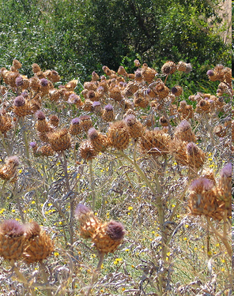
More CO₂ = increased plant growth
Canada thistle shows
70% increase
Also…
Increased water efficiency
Increased combustibility
Decreased palatability
Reduced herbicide effectiveness
Janet Garcia

Slide 21
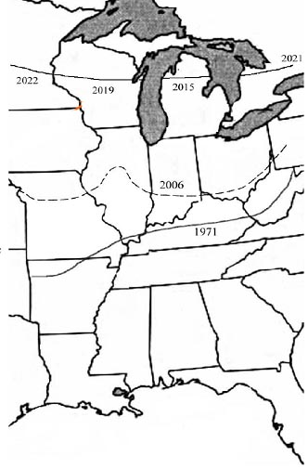
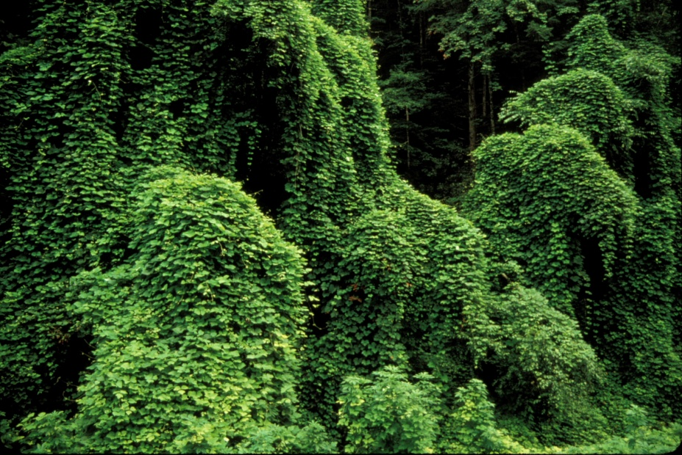
Shift toward higher latitudes
Kudzu moving north…
USDA-ARS (Ziska, Lewis from presentation “Climate Change and Invasive Weeds” at Northeastern Weed Science Society Annual Meeting, Jan. 8-10, 2008

Slide 22
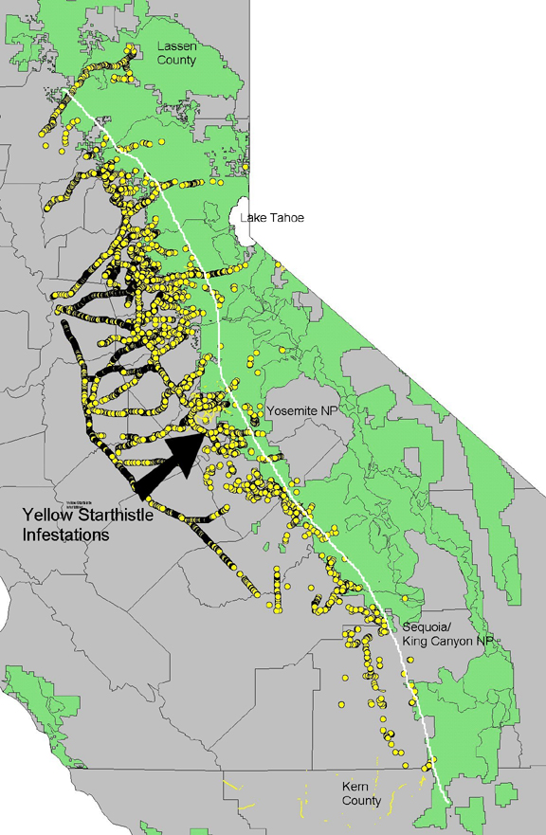
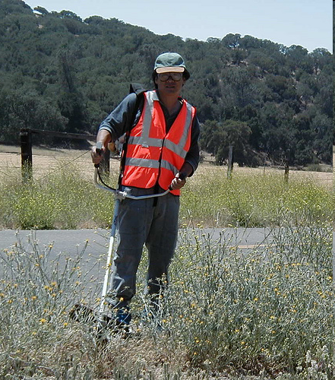
Shift to higher elevations
Yellow starthistle
moving up into
the Sierra Nevada…
CDFA

Slide 23
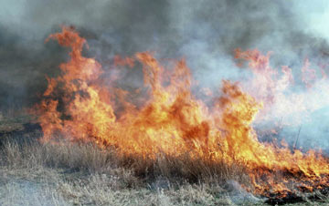
Increased fire
Can exacerbate positive feedback cycle
with pyrophilic weeds
Cheatgrass (Bromus tectorum) in Great Basin drives habitat type conversion
NRCS

Slide 24

Climate adaptation
“Reducing existing stressors on fish, wildlife, and plants may be one of the most effective, and doable, ways to increase resilience to climate change.”
Strategy 7.3 on invasive species… “Implement existing national, state and local strategies and programs for rapid response to contain, control, or eradicate invasive species, and develop new strategies as needed.”

Slide 25
Common recommendations
Review of last 22 years of articles on conservation measures to address climate change:
  Increase connectivity (reserve design)
  Include climate change in all planning
  Reduce stressors like IS
  Improve inter-agency, regional coordination
  Improve predictive capacity
Heller and Zavaleta, Biological Conservation, January 2009
Notes:
State Wildlife Action Plan

Slide 26
Broaden scope
In general, we’ll need greater integration of planning and resource management…
across wider geographic areas,
on longer time-scales, and
involving more diverse actors
…than in current practice.
Heller and Zavaleta, Biological Conservation, January 2009

Slide 27
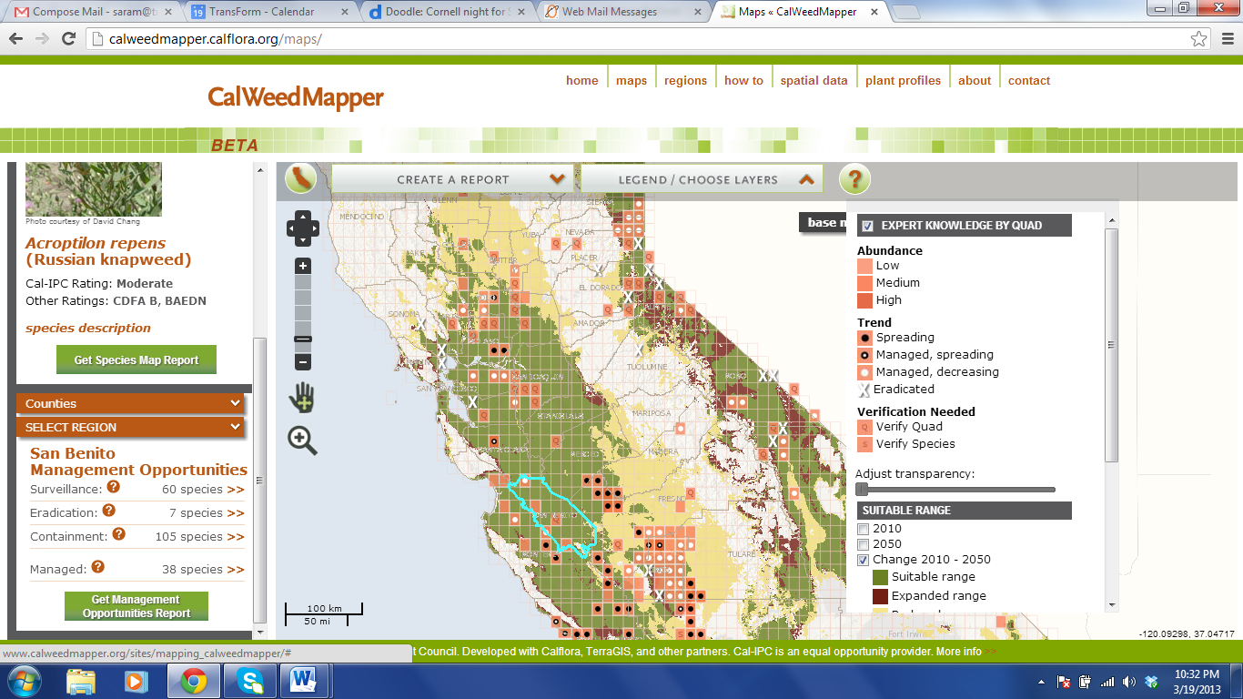
Decision support

Slide 28
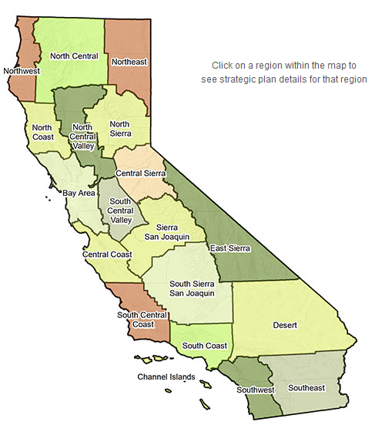
Landscape-scale strategy
Using CalWeedMapper with regional partners to develop work plans and seek funding.
Working on prioritization with Cal State Parks, Dept. of Defense, US Forest Service, US Fish & Wildife Service…
Regional eradication, surveillance for early detection/rapid response.

Slide 29
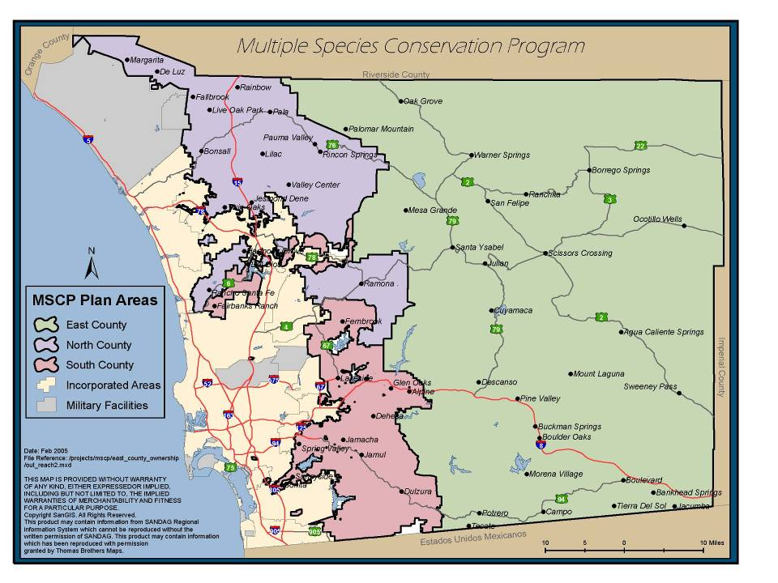
NCCP integration
Notes:
Determine management regions, evaluate weed priorities, match against listed species impacts,

Slide 30
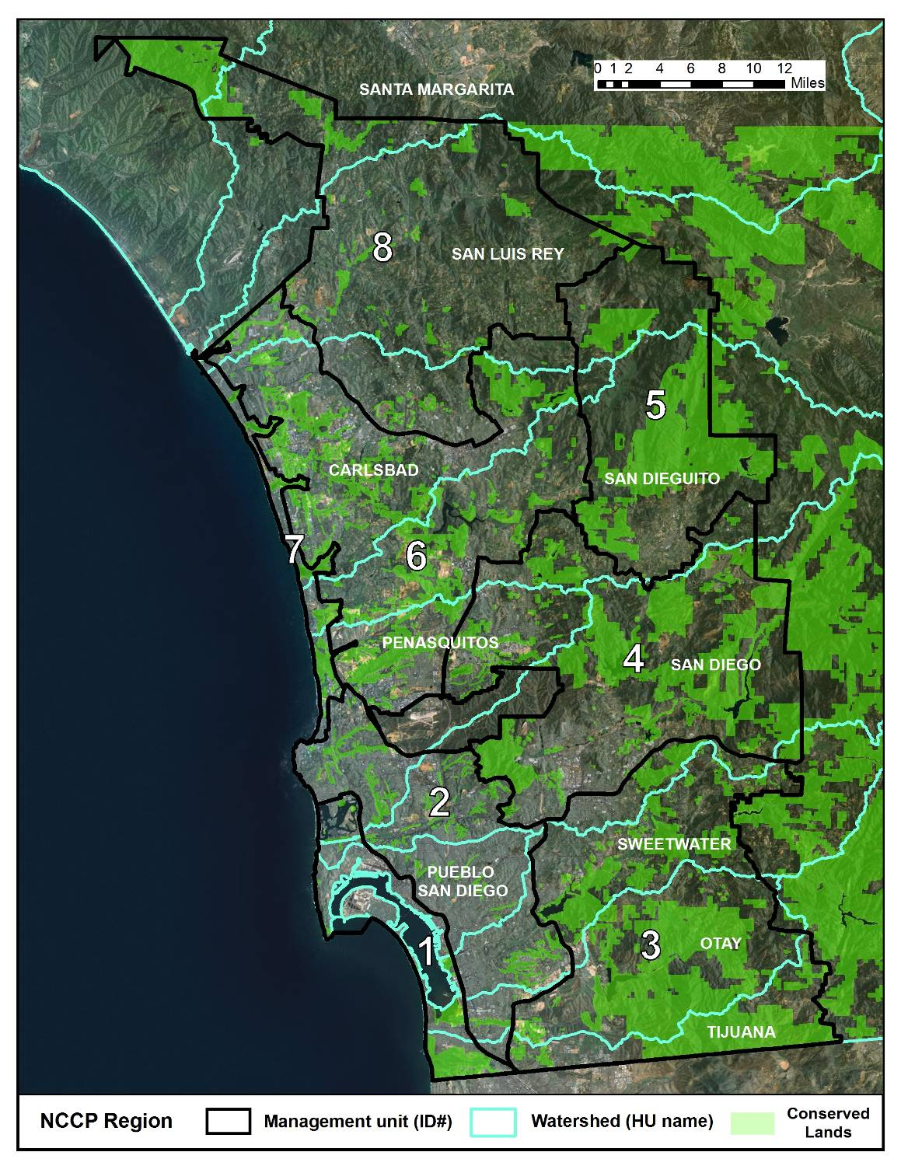
NCCP Region
8 Management Units
11 Watersheds
Notes:
30
Point out some plants are managed by region, others by management unit/watershed, others at the reserve scale

Slide 31
Strategic Plan—Blueprint for Action
Prioritize invasive species threats regionally and by management unit, according to management categories:
  Surveillance (Level 1)
  Eradication (Level 2)
  Containment (Level 3)
  Managed (Level 4 & 5)
Develop multi-year plan for action, including specific projects for early implementation.
Develop database of acreages, timeframes, permits, and costs for control and monitoring, by management unit and regionally.
Provide resource library on SDMMP website.
Notes:
31
Quick outline of goals for plan

Slide 32
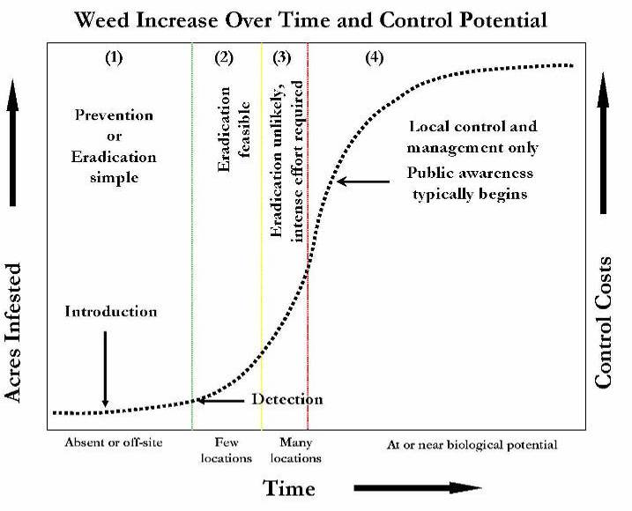
Study: Rejmanek and Pitcairn 2002
Graphical representation: Siemens and Tu 2007
Notes:
32
Quick review of the invasion process.
Early action allows eradication, delayed action allows only partial control, and no action results in full invasion and localized management.
Note Rejmanek Pitcairn study that few plant invasions that are over several hectares in size were eradicated over a 30 year time span by CDFA.

Slide 33
Management Levels
Level 1- Surveillance
(ERADICATED)
Level 2- Eradication
Prioritization by PAF score
Level 3- Containment
Level 4- Management
Level 5-
Suppression
ABUNDANCE/
MANAGEABILITY

Slide 34
Level 2 - Eradication (region-wide)
Description: Species has very limited distribution.
Goal: Eradication with regionally coordinated program.
Recommendations:
Develop aggressive and coordinated eradication programs.
Implement initial eradication projects that bring projects to within the management capacity of existing reserves.
Monitor past eradication sites.
Maintain occurrence database.
Coordinate early detection program and respond to new populations.
Update existing PAFs and review and develop new PAFs for additional species.
Educate managers and crews on BMPs.
Notes:
34

Slide 35
Scientific Name | Common Name | Regional Priority | San Diego PAF score | # of Sites | Control Effort
Aegilops triuncialis | Barbed goat grass | High | Not reviewed | 1 | Small
Ageratina adenophora | Eupatory | High | 5.4 | 2 | Small
Carrichtera annua | Ward’s weed | High | 4.2 | 3 | Small
Centaurea calcitrapa | Purple star thistle | Low | 2.8 | 1 | Small
Centaurea solstitialis | Yellow star thistle | High | 5.9 | 18 | Moderate
Centaurea stoebe ssp. micranthus¹ | Spotted knapweed | Medium | 6.0 | 4 | Small
Elymus caput-medusae | Medusahead | Very high | 6.1 | 6 | Large
Genista monspessulana | French broom | Very high | 6.9 | 5 | Moderate
Hypericum canariense | Canary Island St. John’s wort | High | 5.9 | 10 | Large
Iris pseudacorus | Yellow flag iris | High | 5.6 | 6 | Small
Lythrum salicaria | Purple loosestrife | Very high | 8.1 | 2 | Small
Retama monosperma | Bridal broom | Very high | 6.4 | 5 | Moderate
Notes:
35
12 species were placed in Management Level 2- eradication may be achievable goal regionally.
Three of them (in gray) will be looked at in additional slides.
For each species examined, all known populations are describe in terms of management.

Slide 36
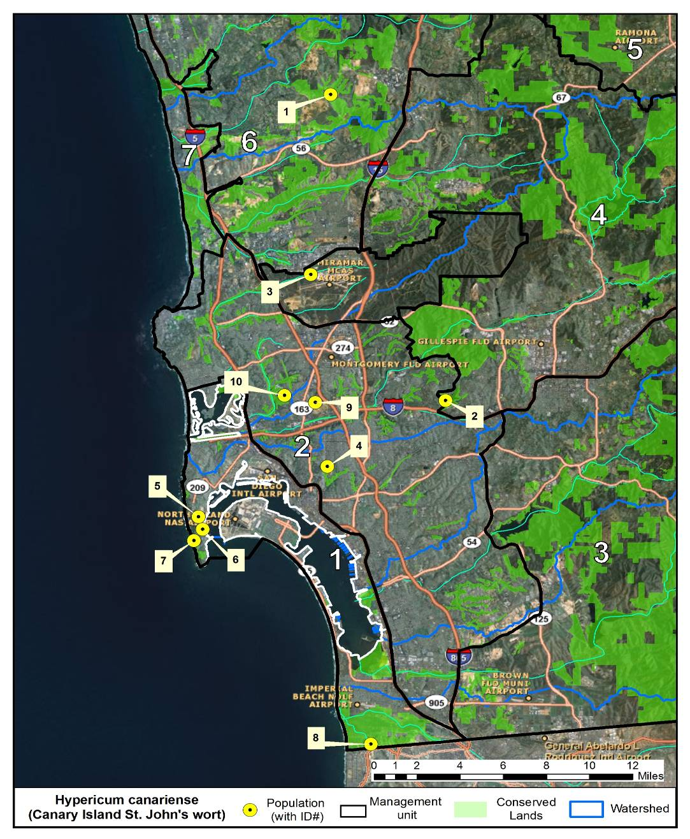
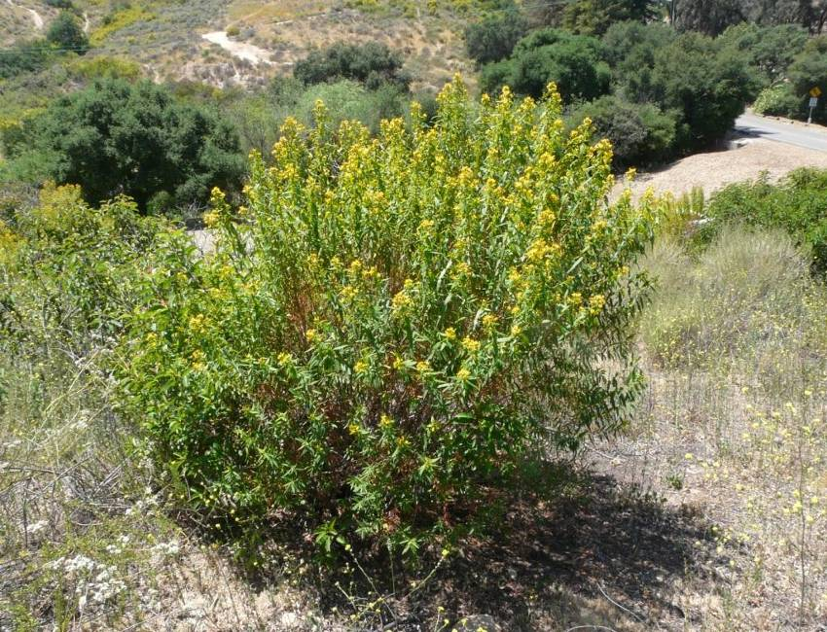
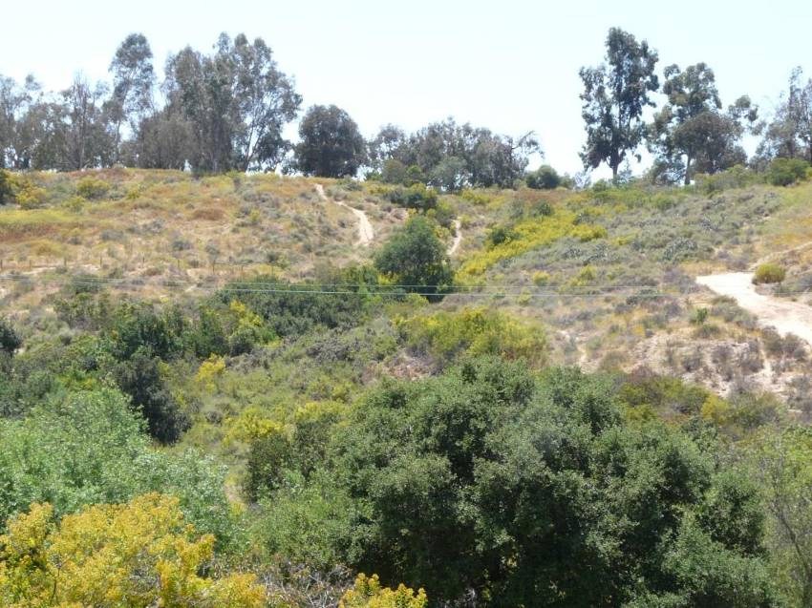
Level 2 Eradication: Hypericum canariense, SD PAF score 5.9
Notes:
36
This species has been present in the region for some time, but appears to be expanding more rapidly. Lag phase (build-up of propagules) may be over?

Slide 37
# | Location | Size | Status | Duration | Funding Status | Lead
1 | Lusardi Creek, Black Mountain | <1 acre in 200-acre area, mostly seedlings | Re-treatments | Since 2008 | Funded: <$3K | City of San Diego
2 | Lake Murray, La Mesa: a) City of SD b) San Diego Public Utilities | a) <1 acre in 200- ac area, mostly seedlings b) ~5 acres, 5,000-10,000 scattered plants | a) Re-treatments b) Not treated | a) Since 2009 b) not treated | a) Funded: <$2K b) Unfunded: Initial cost: ~$30K Annual re-treatment ~$5K | a) City of SD b) San Diego Public Utilities
3 | MCAS Miramar | Eradicated | Eradicated | Completed | N/A | MCAS Miramar
4 | Florida Canyon, Balboa Park | ~10 acres | Not treated | Not treated | Unfunded: Initial cost: ~$50K Annual re-treatment ~$5K | City of San Diego
5 | Naval Base Point Loma Fuel Yard | 1 acre, many sites | Ongoing | Since 2008 | Funded | Naval Base Point Loma
6 | Naval Base Point Loma @ Steam Plant Rd | 1 acre, many sites | Ongoing | Since 2008 | Funded | Naval Base Point Loma
7 | Naval Base Point Loma @ Loma Gatchell Rd. | 1 acre, many sites | Ongoing | Since 2008 | Funded | Naval Base Point Loma
8 | Borderfield State Park32 | <1 acre, 50 plants | Will be initiated in 2012-2013 | Not treated | Funded | State Parks
9 | Mission Center Rd. above Friars Rd., North Mission Valley | ~1 acre 500 plants | Not treated | Not treated | Unfunded: Initial cost ~$15K; Annual re-treatment ~$2K | City of San Diego
10 | Manning St, Tecolote Canyon | ~5 acres 5,000-10,000 plants | Not treated | Not treated | Unfunded: Initial cost ~$50K; Annual re-treatment ~$5K | City of San Diego
Notes:
37
Again, not going over in detail.
About half the sites are undergoing treatment, but three of the largest sites are not being treated (Tecolote, part of Lake Murray and Florida Canyon).
Role of SDMMP – coordinate and initiate control on all populations, providing funding where needed.

Slide 38

Landscape-scale strategy
Coordinate partners
Set priorities
Fund and implement projects
Provide long-term support
Notes:
38

Slide 39
Contact
Cal-IPC: www.cal-ipc.org
Doug Johnson: dwjohnson@cal-ipc.org

